Slide 1
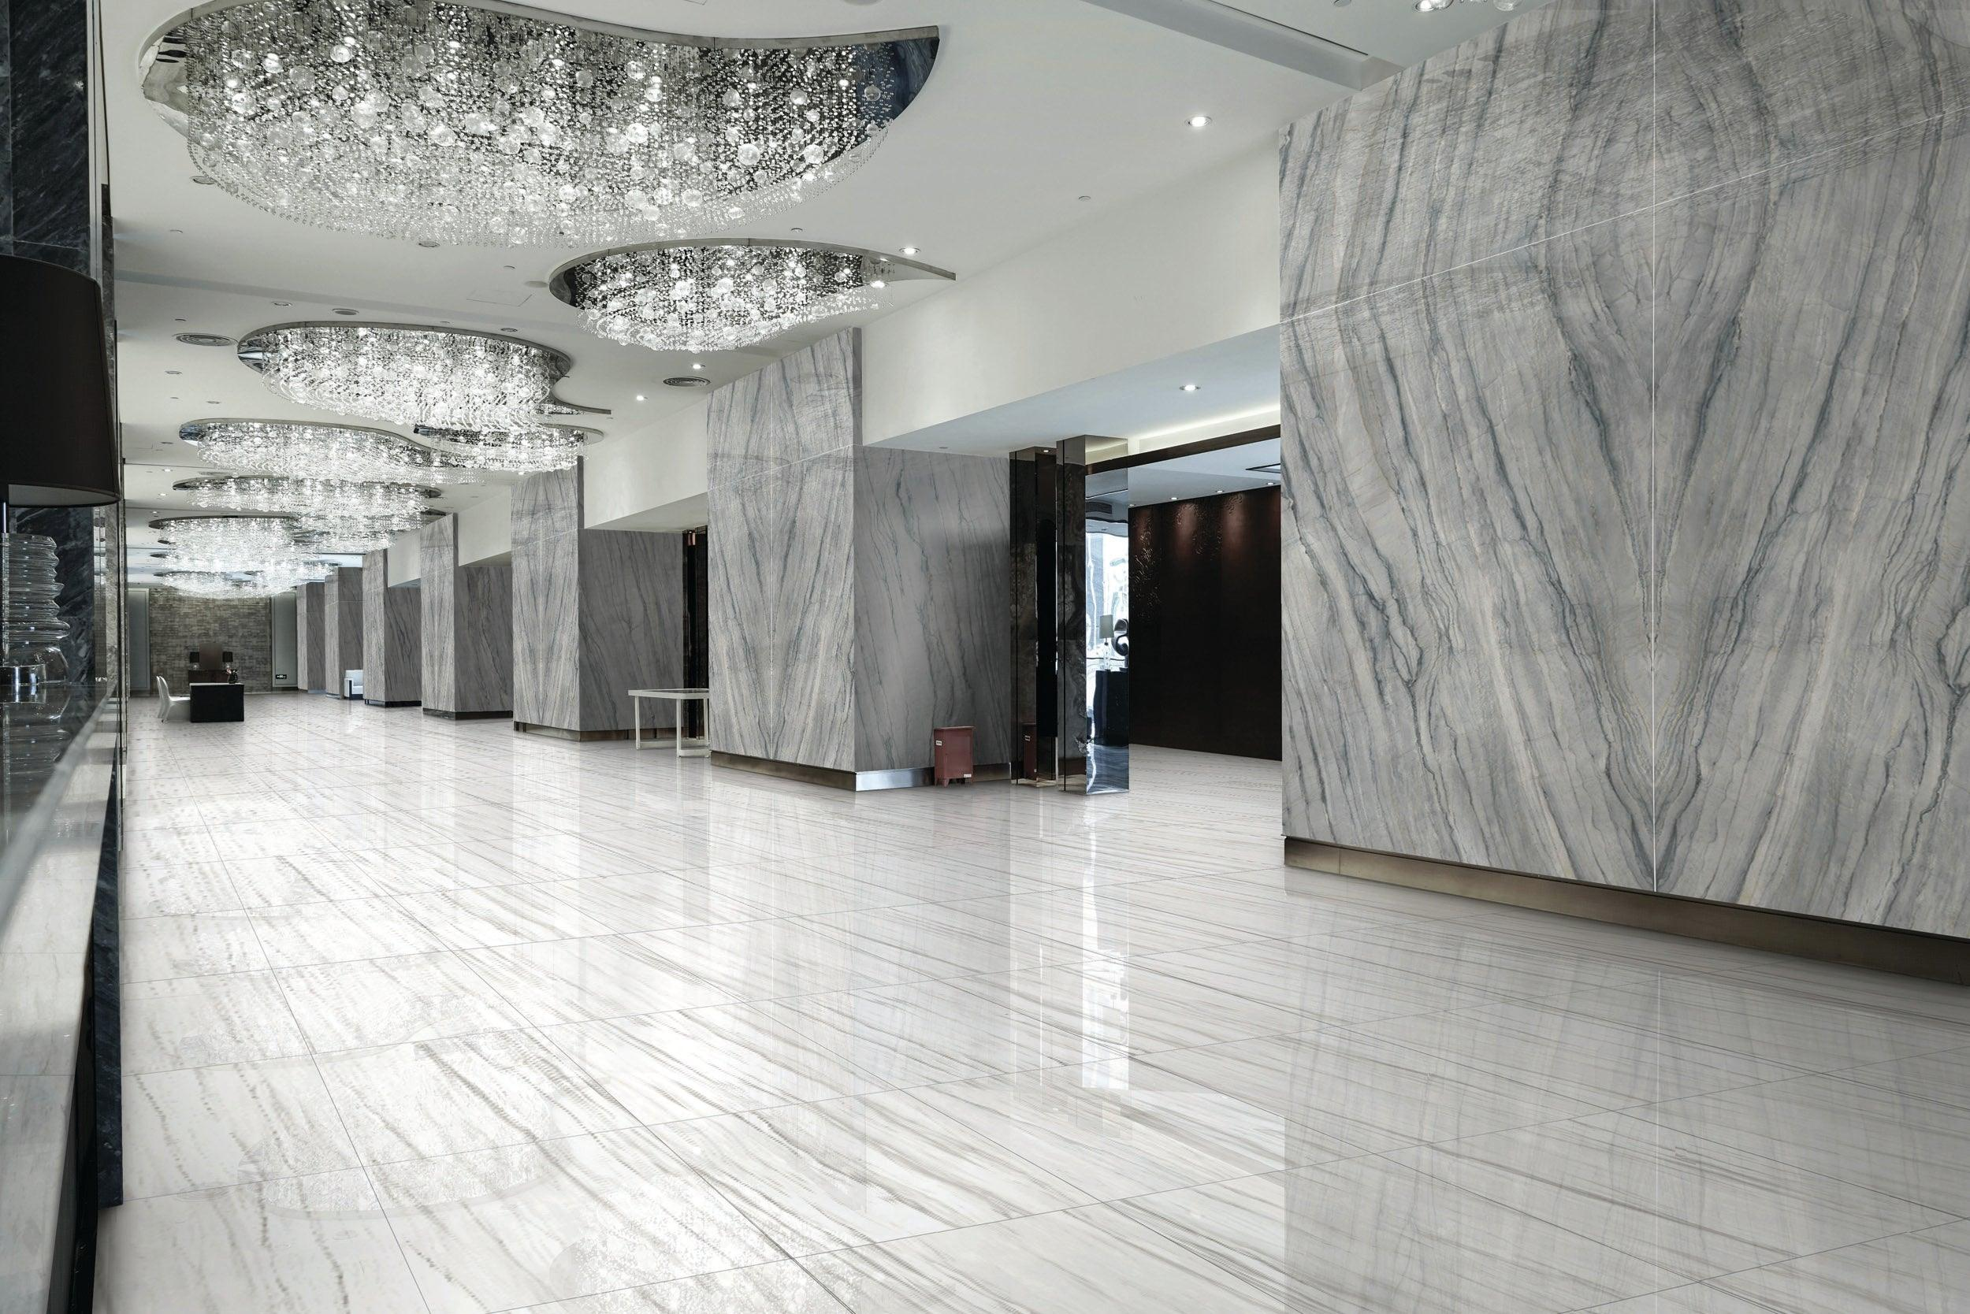

Company Profile

Slide 2
Venius Resources Limited
Our Company
Venius is a Nigerian incorporated trading Company, specialized in to, among other things, carry on the business of General Merchandise/Trading, General Contracts, Supplies, Distribution of General Goods, Sales and Services.
We always maintain an unbroken supply chain in;
High Quality Materials, for Building Construction
Sales and Installation of Fittings
Industrial Facility Maintenance
Civil Engineering Support/Services

Slide 3
Venius Resources Limited
Our Mission
At Venius, our mission is to provide the best quality building and construction materials, along with cost-effective solutions, thus building sustainable relationships with our customers, products manufacturers, our distributors and all of the stakeholders, along our business value chain.

Slide 4
Venius Resources Limited
Our Vision
The operating culture at Venius Resources, aligns with “minds wide open” attitude, thus creating dynamic solutions for the inevitable challenges that occur on daily basis. We stay on the critical path required to provide seamless and profitable solutions in the world of cross border commodity transactions

Slide 5
Venius Resources Limited
Our Strategy
Our business approach is anchored on the following strategies;
Products Quality and Reliability
Sustainable Products Supply Chain Systems across West Africa
Safe and Timely Delivery
World-class Storage and Inventory Management Systems
Dedicated Expert Product Analysis, to ensure preservation of the highest industry standards

Slide 6
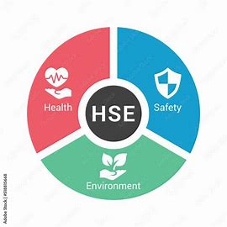
Venius Resources Limited
Our Health Safety & Environment (HSE) Policy
We recognise the importance of our host communities, the environment, safety/health of our staff & partners and the general wellbeing of all our stake holders. Our HSE policy is driven by the following statements:
Ensuring that our stakeholders and immediate communities are treated with equity, respect and honesty

Slide 7
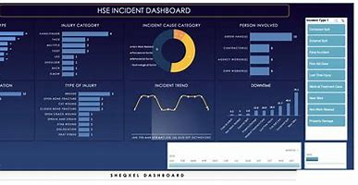
HSES PERFORMANCE/COMPLIANCE STATISTICS
Cumulative, Historical Manhours -
Cumulative Contracts Value -
HSES Stats -
NPT/MBTF -
Contract Performance -
HCD Performance Index -
NCD Performance Score -
Growth Performance -
CSR Performance -
375,000
$455,000,000.00 0 NLTI
0.5%
0 Termination
90%
75%
80%
70%

Slide 8
Venius Resources Limited
Our Products and Services
Glossy Wall Tiles
Natural Marble Collections
Natural Granite Collections
Adhesive Grout and other Materials
Light-gauge Steel Profile
Distribution across Nigeria and West AfricA
Retail and Local Supplies

Slide 9
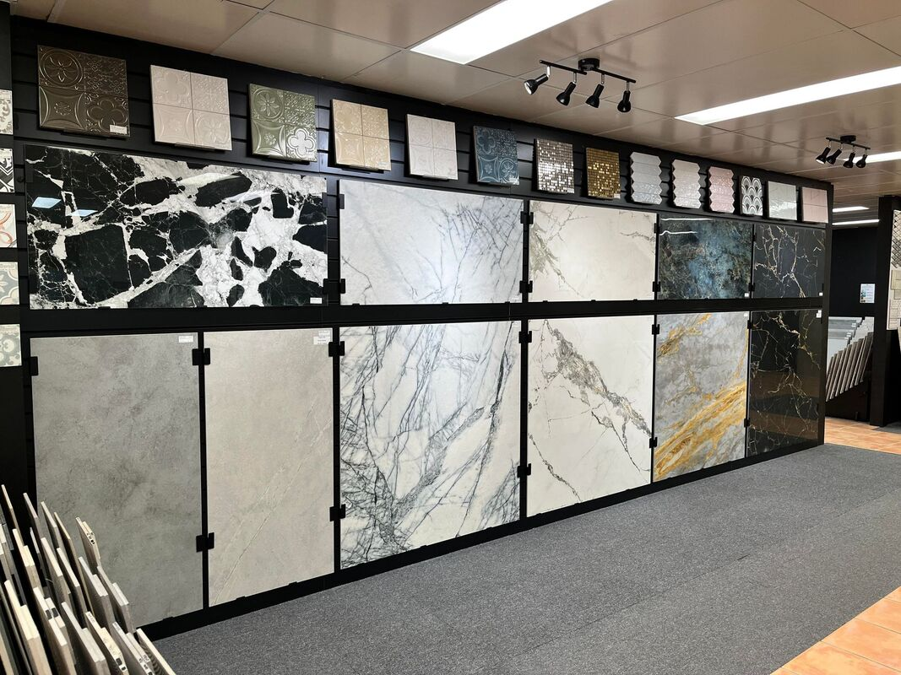
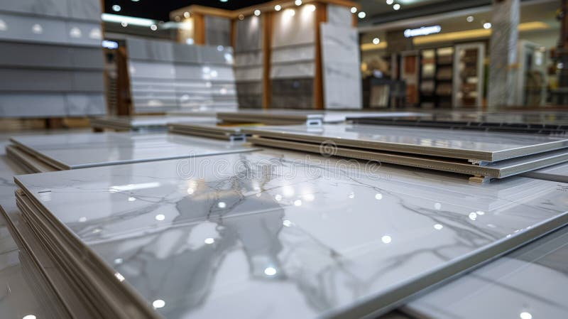
Venius Resources Limited
Our Sales Outlets

Slide 10

Venius Resources Limited
Our Products and Services

Slide 11
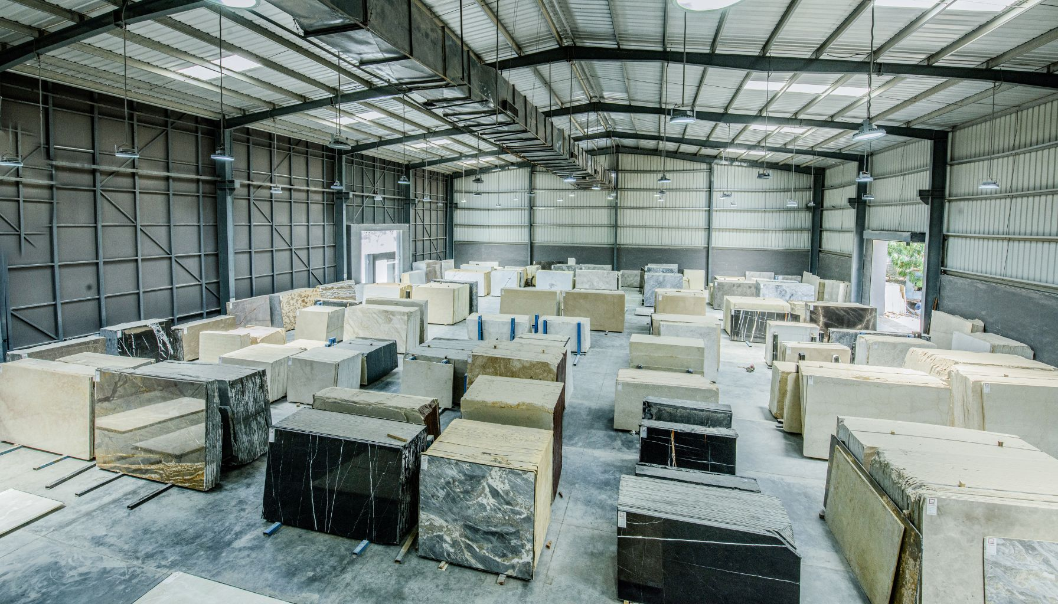
Venius Resources Limited
Our Products

Slide 12

Venius Resources Limited
Our Products and Services

Slide 13
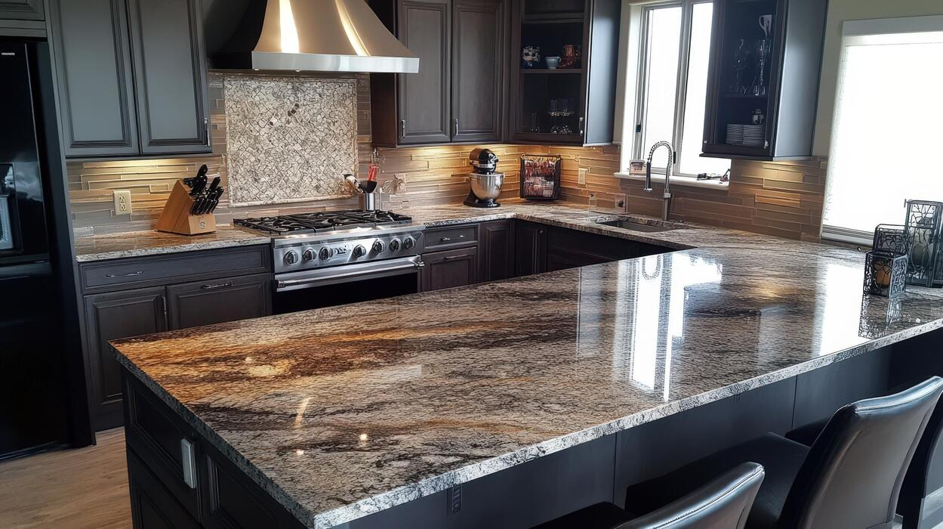
Venius Resources Limited
Our Products and Services

Slide 14
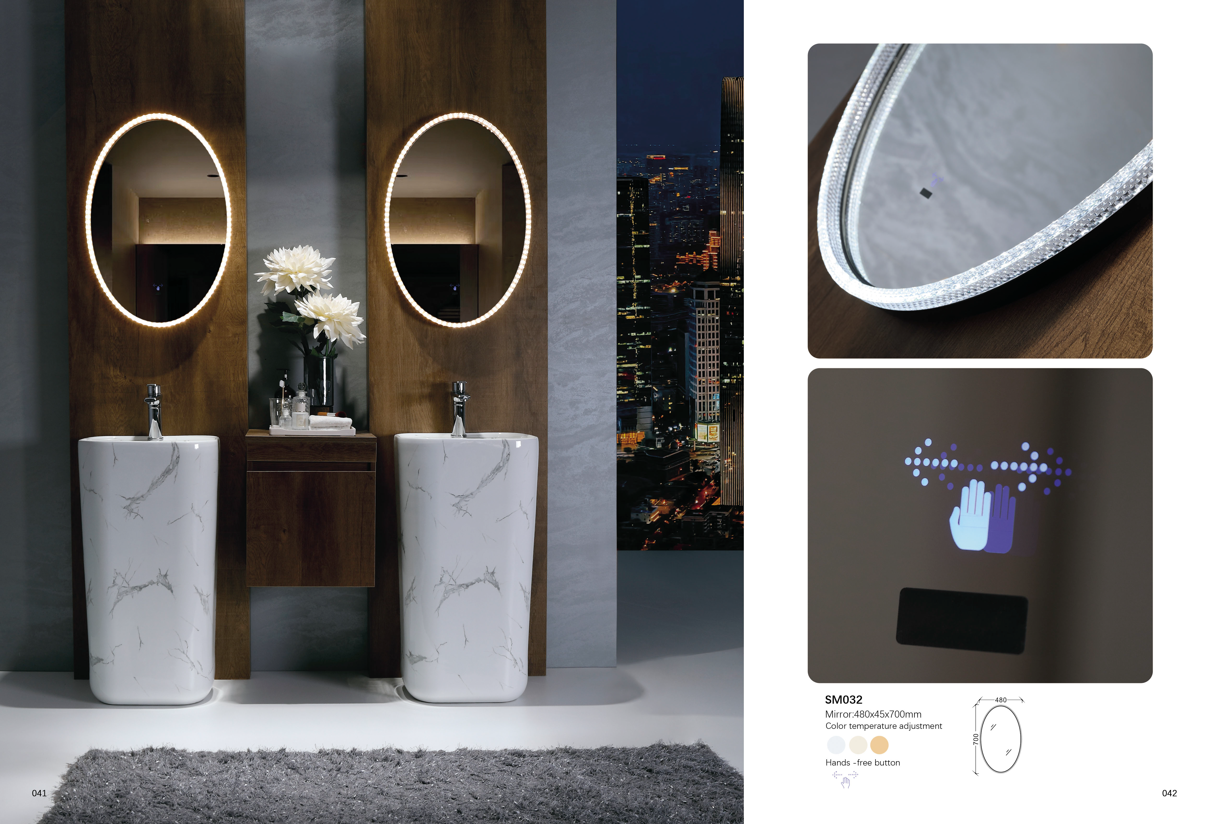
Venius Resources Limited
Our Products and Services

Slide 15
Venius Resources Limited
Our Products and Services

Slide 16

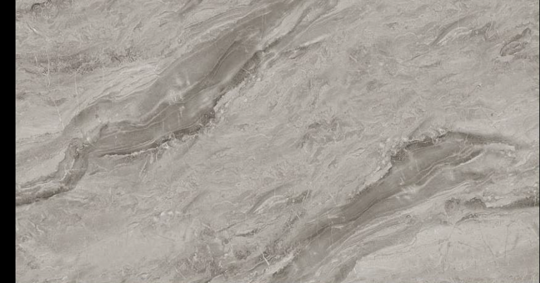
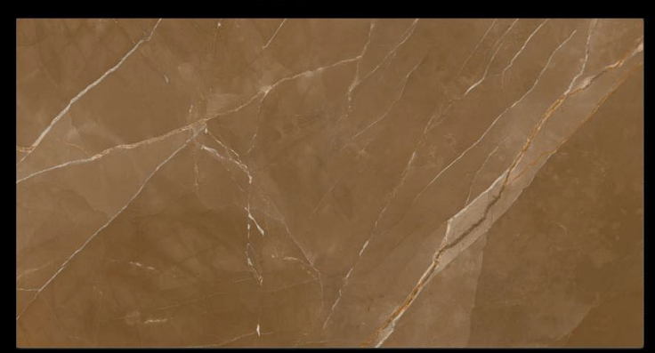
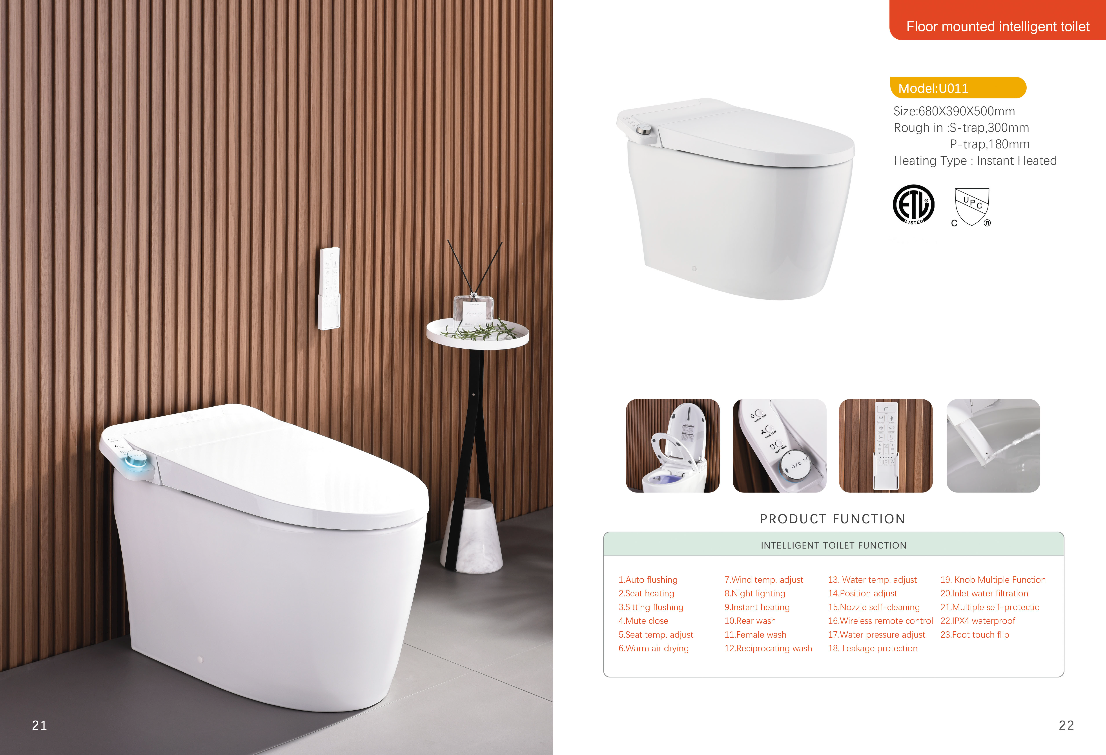
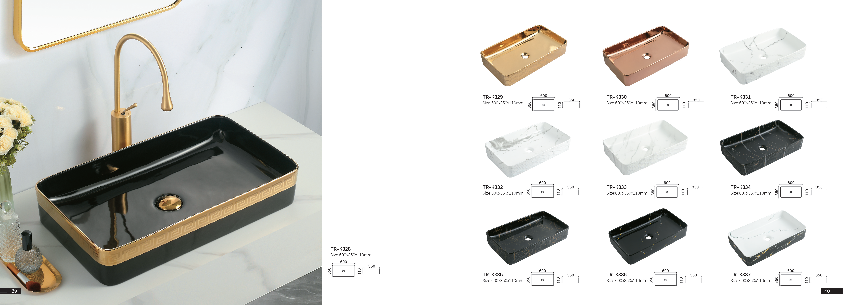
Venius Resources Limited
Our Products and Services

Slide 17

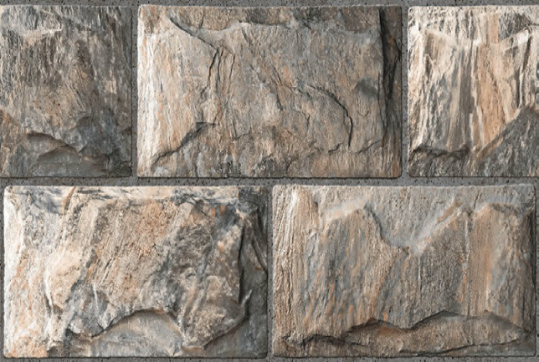




Venius Resources Limited
Our Products and Services

Slide 18
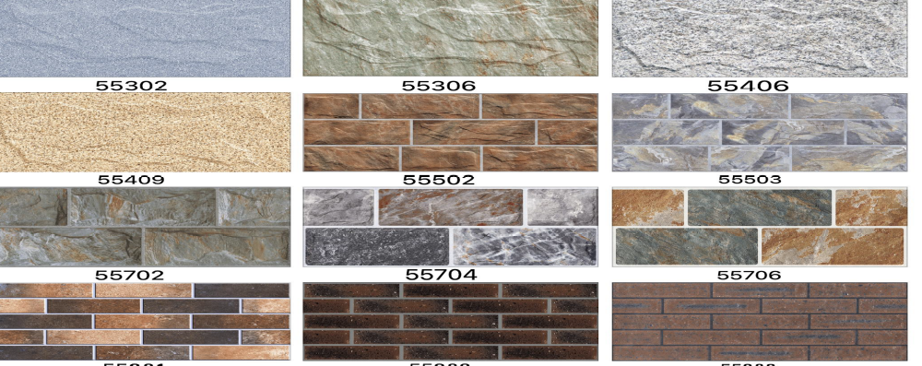
Venius Resources Limited
Our Products and Services

Slide 19
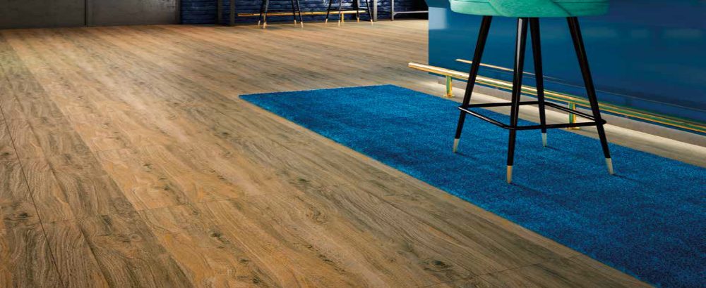
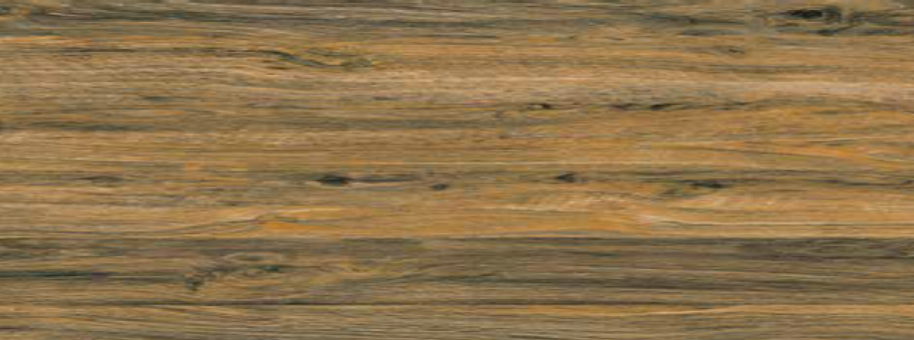
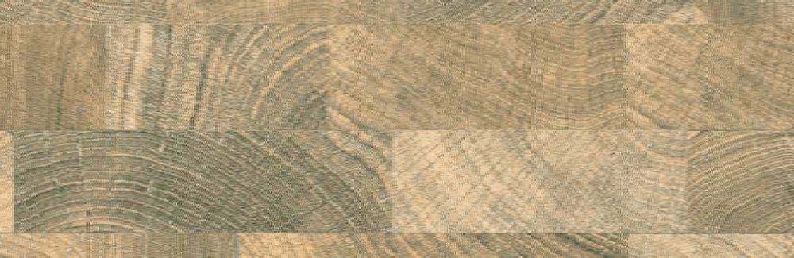
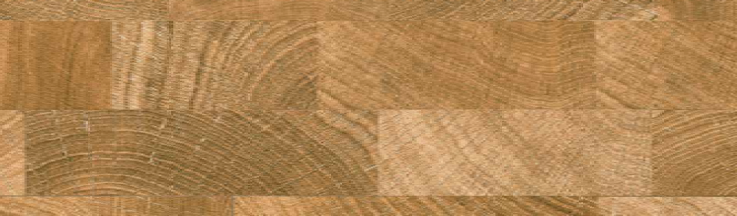
Venius Resources Limited
Our Products and Services

Slide 20










Venius Resources Limited
Our Global Partners

Slide 21











Venius Resources Limited
Global Certifications
OurOur

Slide 22
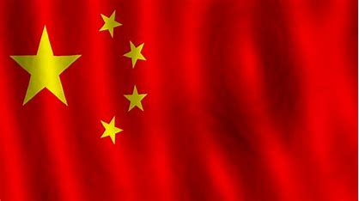






Venius Resources Limited
Global Network/Footprints
Our
Our

Slide 23
Venius Resources Limited
Distribution Coverage in Nigeria
Abia Ebony Kebbi Abuja - FCT
Adamawa Edo Kogi
Akwa Ibom Ekiti Kwara
Anambra Enugu Lagos
Bauchi Gombe Nasarawa
Bayelsa Imo Niger
Benue Jigawa Ogun
Borno Kaduna Ondo
Cross River Kano Osun
Delta Katsina Oyo
Rivers Sokoto Yobe
Plateau Taraba Zamfara
Our

Slide 24

Venius Resources Limited
Our Contact
Corporate Office: Branch Office:
228, Oron Road 27, Timber Market Road
Mbiabong, Uyo Off Oron Road
Akwa Ibom State Uyo, Akwa Ibom State
Email: info@veniusresources.com
Website: www.veniusresources.com
Tel: +234 7013 293 780; +234 8027 470 247; +234 8039 140 792

